Slide 1

Data Watchdog
Presented by Team CodeRed
01

Slide 2
Features
01
Data Ingestion and Continuous Integration
02
PII Detection & Identification
03
Analytics & Data Visualization
04
Data Drilldown
02

Slide 3
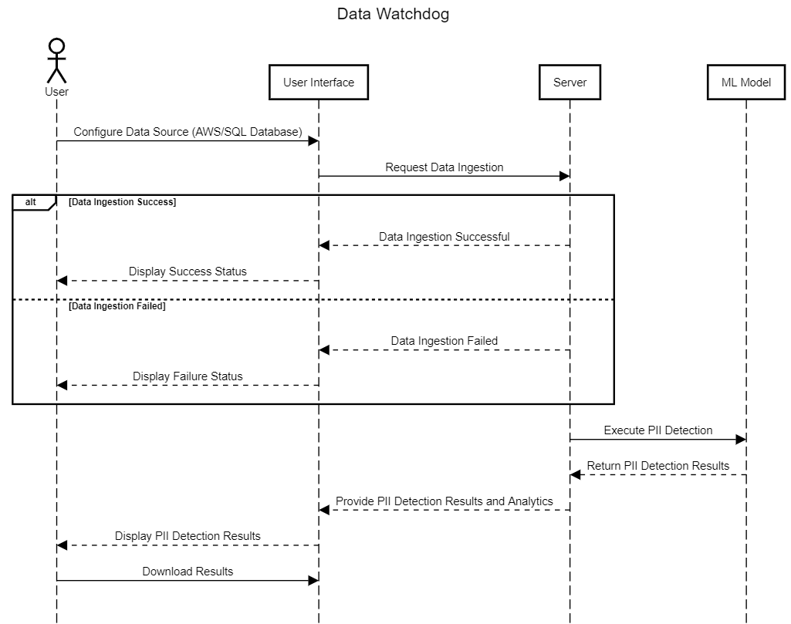
Sequence Diagram
To get started, users must configure their preferred data store, such as AWS Cloud Store or SQL Database, through an easy-to-use form where they can enter their credentials. Once connected, the server automatically downloads the files. If there's a connection issue, users will be notified.
Afterward, the server runs a machine learning model to detect Personally Identifiable Information (PII) and generate detailed analytics. Users can also download their files anytime.
03

Slide 4
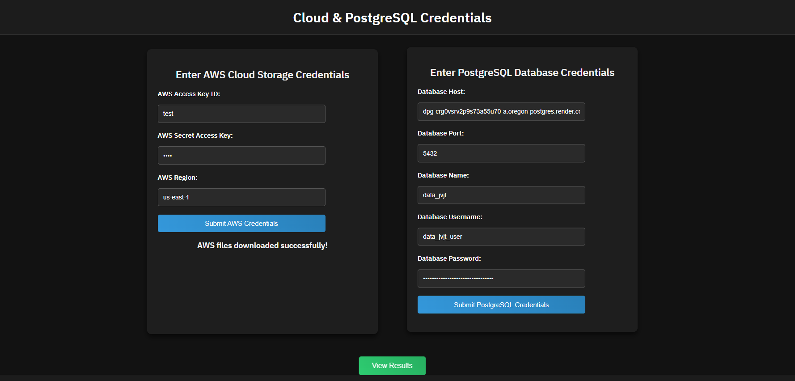
Data Ingestion
Key Features:
Credential-Based Setup: Users provide AWS and PostgreSQL credentials, and we handle the rest automatically.
Automated Data Fetching: Data is fetched at scheduled intervals for real-time analysis.
PII Detection: Supports all file types (PDF, CSV, PNG, TXT, DOCX, MP3, MP4) for PII analysis.
Complete Automation: No manual intervention needed, providing continuous updates and insights.
04

Slide 5
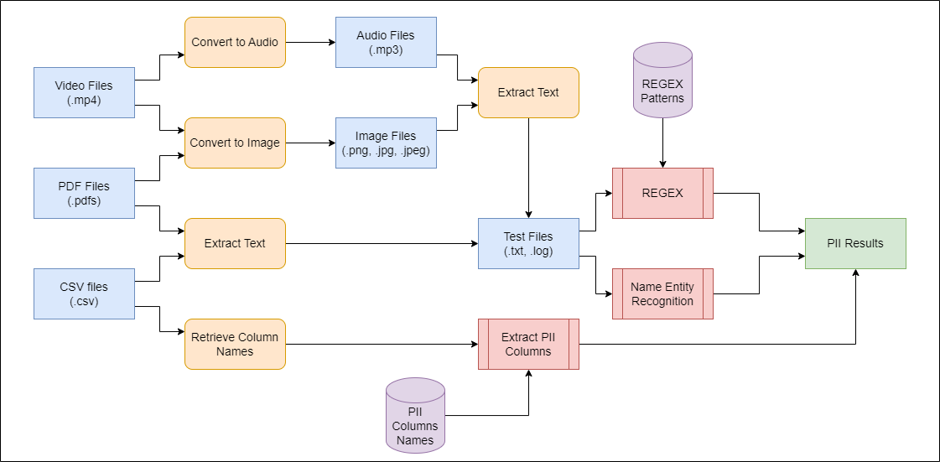
Methodology
05

Slide 6
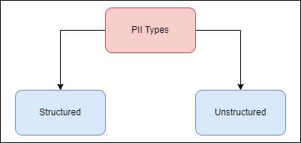
Methodology
PII can be classified into two types:
Structured PII: Follows a specific format, such as an Aadhar number (XXXX XXXX XXXX). REGEX is used to detect these structured patterns, like email addresses, IP addresses, and credit card numbers.
Unstructured PII: Does not follow a fixed pattern, like city names (Mumbai, New York). Name Entity Recognition is used to identify these unstructured PIIs by recognizing entities like personal names, locations, and organizations.
For CSV files, we also check column names to detect potential PII.
06

Slide 7
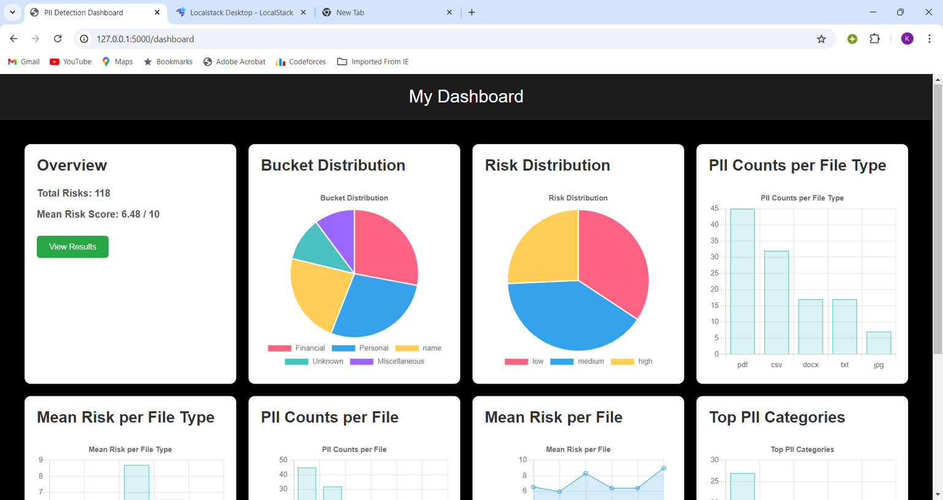
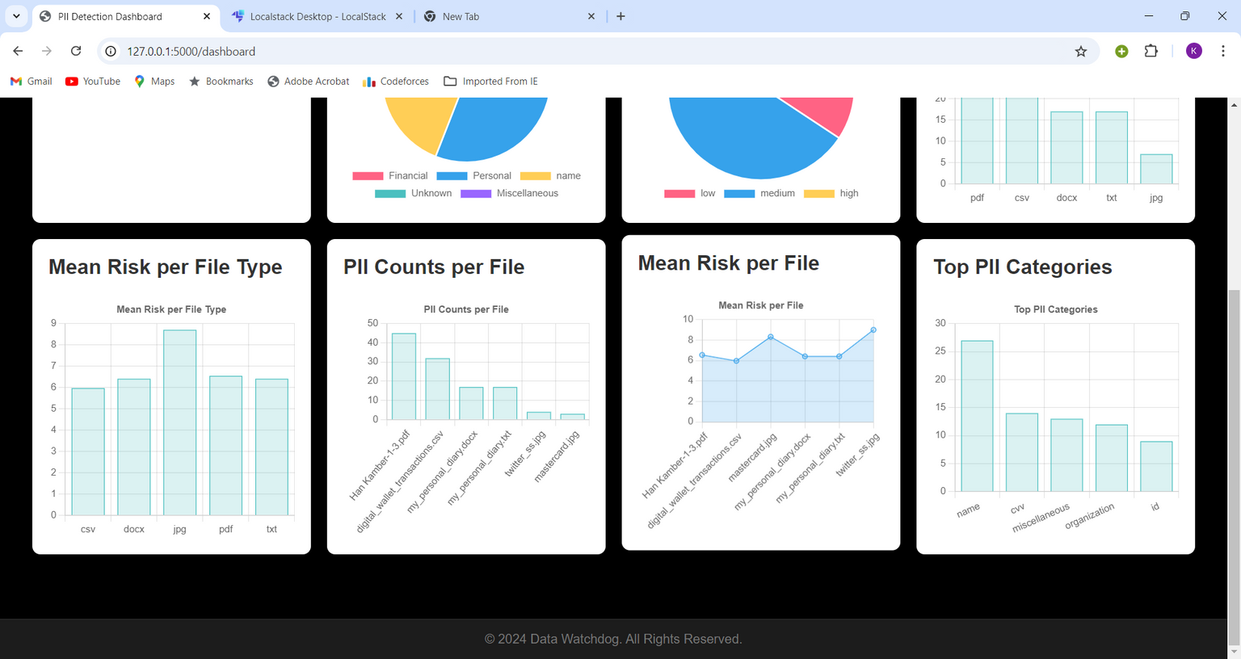
Dashboard
We offer the following analytics and results to user based on PII Detected:
Total Risks
Mean Risk Score
Bucket Distribution (e.g. Personal, Financial, Medical etc.)
Risk Distribution (e.g. High,Med,Low)
PII Counts per File Type
PII Counts per File
Mean Risk per File Type
Mean Risk per File
Top 5 PII Categories (e.g. Name, Email, CVV etc.)
07

Slide 8
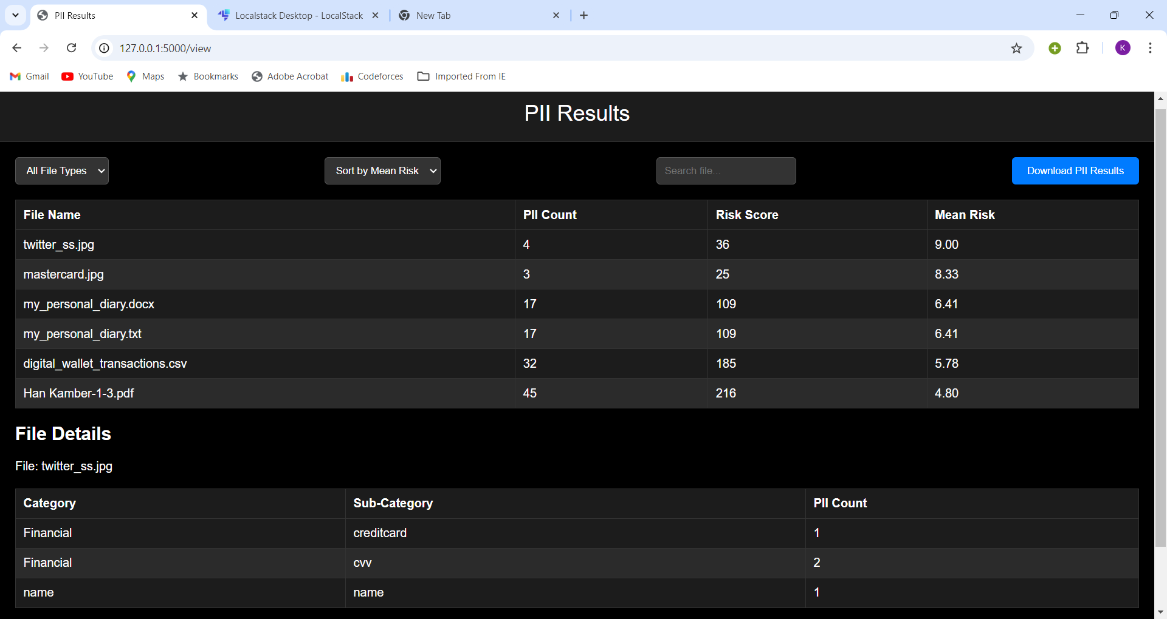
Drilldown on Results
08

Slide 9
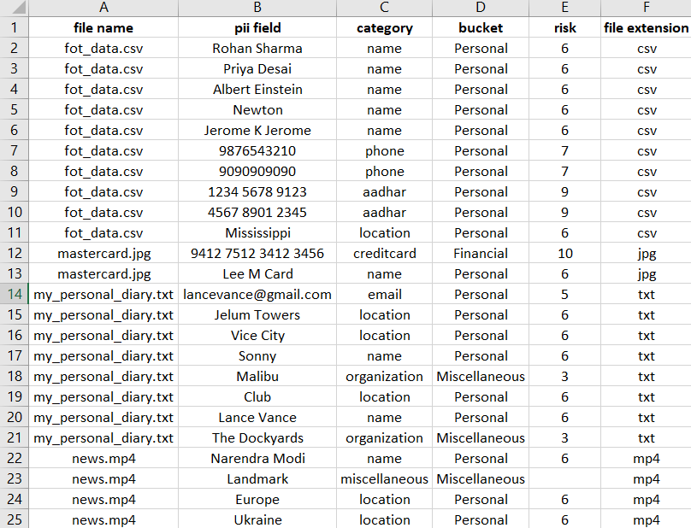
PII Analysis Results
Comprehensive CSV Report:
Detailed breakdown of all identified PII
Includes file name, PII field, category, risk level, and file type
Risk Levels:
Critical (10): Credit card details.
High (9): Aadhaar numbers.
Moderate (5-7): Names, phone numbers, emails.
Low (3): Organization data.
Distribution:
Financial Category: Detected in files such as mastercard.jpg, with critical PII like credit card numbers.
Personal Category: Spread across files like fot_data.csv and my_personal_diary.txt, containing names, phone numbers, Aadhaar numbers, and email addresses.
Miscellaneous Category: Includes less sensitive data, such as organization names and locations, with lower risk scores.
09

Slide 10
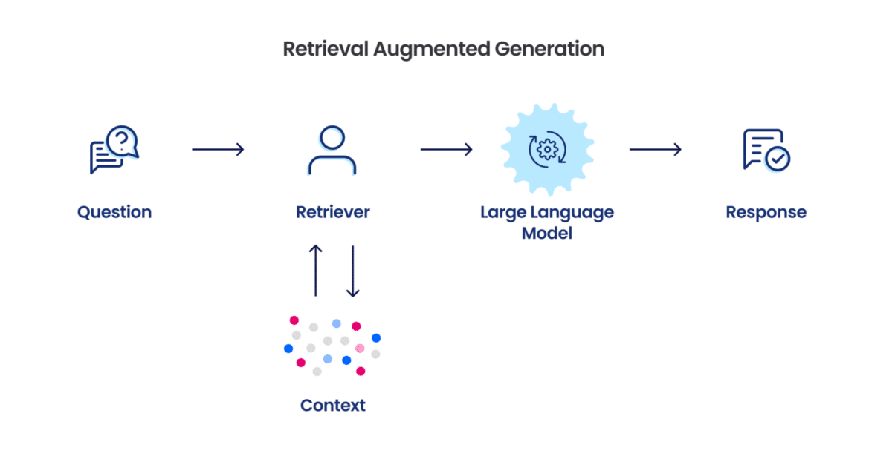
Future Scope
1) Chatbot Integration: We want to add a chatbot to the analytics page. This will let users ask questions in plain language, like “How many PII records are in news.mp4?” The chatbot will give quick answers, making it easier for everyone to access information.
2) Better PII Detection Techniques: Right now, our system has trouble finding certain medical PII, like insurance numbers and birth certificate numbers, because the data isn’t organized well. We plan to research how to improve this and better detect these important types of PII.
10

